Slide 1

Dark Dealings
Passion Games
Notes:
Newly formed indie studio
Working on discovering gaps in the market

Slide 2
High Concept of the Game
Top down 2D stealth game
Story led main levels and non-story side missions
Dystopian cyberpunk setting
Player must navigate levels, avoiding enemies to reach an objective
Notes:
A top down 2D stealth adventure game set in a dystopian future where the player – a cybernetically enhanced spy - must use non-lethal methods and stealth to navigate levels, avoiding enemies’ cones of vision. The player must steal information in each level to sell to the black market. The player can spend resource points – collected throughout the levels – to use abilities such as moving through walls, going invisible or hacking cameras.

Slide 3
Target Audience
Primary - Fans of the stealth and indie genres
Secondary – Fans of Sci-fi, cyberpunk and dystopia genres
Age range - 16+
Platform Audience – Steam and Itch.io
Notes:
Age: 16+ because of mature themes
Average gamer age 35
Indie fans often spread word about games they like

Slide 4
Core Game Mechanics
Stealth – Non-lethal
Low health
Hiding
Sound detection
Hacking – Hack obstacles and some enemies to disable them
Multiple Routes – Replayability and potential for exploration
Abilities – Powerful abilities that use energy
Enemies – Cones of vision
Hub menu level – Shop, select levels and save game
Notes:
Hacking: Cameras, doors, turrets, lasers
Abilities: Walk through walls, short invisibility,
Upgrades between levels for abilities and health/energy

Slide 5
Unique Selling Points
Stealth augmented by active abilities
Player choice – Multiple paths to complete a level
Dystopian cyberpunk setting – Rare among the indie genre
Notes:
Player choice – player has agency through decisions
Stealth game combined with ability casting gives many options

Slide 6
Platform
Steam - £100 fee
Itch.io - Free
Possibility to port to console if successful
Notes:
Easy to port to console – controller support
Steam much more popular <- probably better option despite fees
Itch.io maybe a good first launch platform + prototyping, get reviews

Slide 7

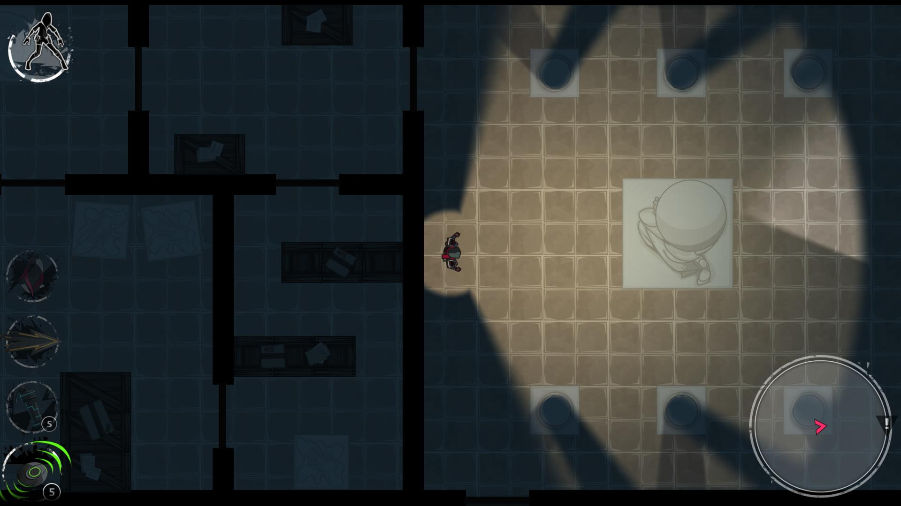
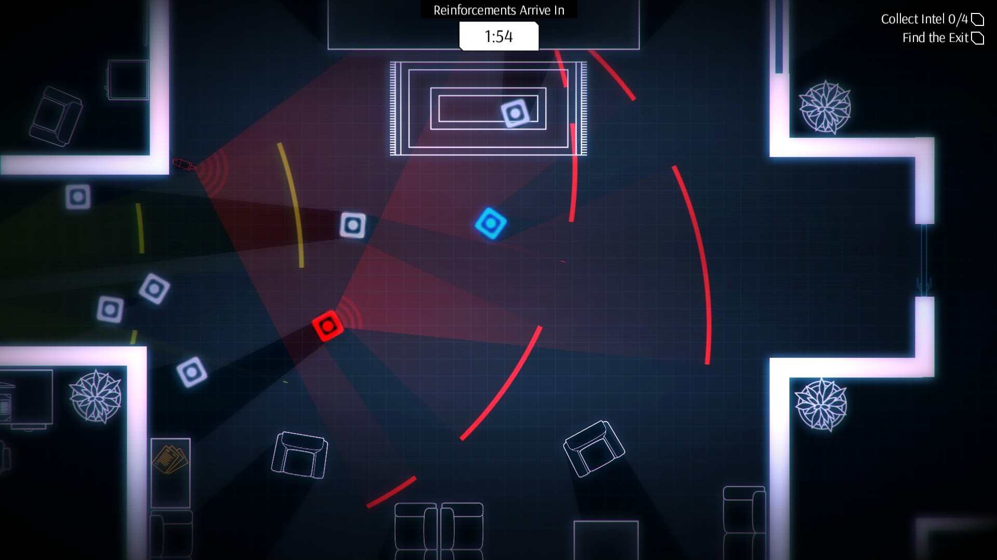
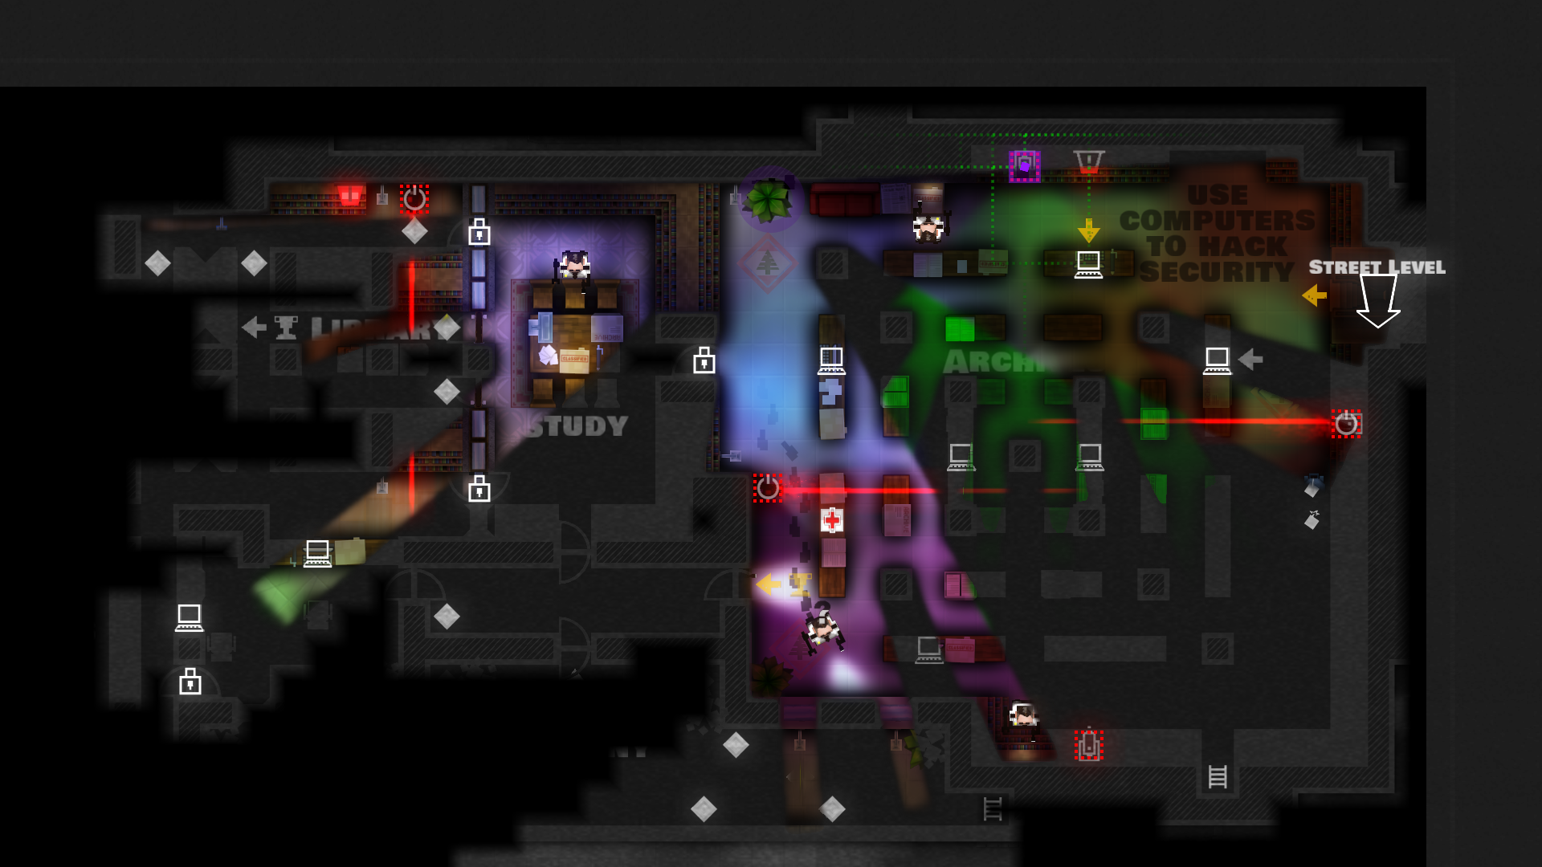
Competition
Mark of the Ninja
Light
Monaco
Steal
Notes:
Mark of the ninja – 28k sales/month
Light 1428 sales/month ← Poor success due to short game and bad story
Monaco 41k sales/month
Steal – Not released yet: will be in direct competition. Lacks the active abilities and has different setting.

Slide 8
Competition
Mark of the Ninja
Steal
Light
Monaco
Notes:
Mark of the ninja – 28k sales/month
Light 1428 sales/month ← Poor success due to short game and bad story
Monaco 41k sales/month
Steal – Not released yet: will be in direct competition. Lacks the active abilities and has different setting.

Slide 9
Development Costs
Estimate of £320,000 for a 24 month development cycle
Salary
Programmers
Artists
Animators
Audio technician
Engine
Web Domain
Equipment
Notes:
13k per month total expenses

Slide 10
Business Offer
Looking for a £320,000 investment
You will receive 40% of net profits
Development will take 24 months
Notes:
40% after steam cuts and monthly expenses

Slide 11
Business Model
Product sales – £10.99
Promotion – Give free copies to streamers/youtubers
Possibility of adding DLC levels – Continued story
Notes:
Same price as similar games
Youtube/twitch very popular with gamers
DLC story levels to boost sales in second year
Free updates and some free dlc <- good relationship with customer

Slide 12
Preliminary Income Projection
Predicted minimum 150,000 sales in the first year
Sales will likely slow after first year
Steam takes a 30% commission
Projected income on Steam after commission - £1,153,950
Notes:
Projected income of £1, 648, 500 in first year
Itch.io has variable commission but lower sales
Similar games: Mark of Ninja 330k in 1 year
Monaco 490k in 1 year

Slide 13
An estimate of the break-even point
10 months for you to break even on investment
Studio will break even with their running costs after 6.5 months
Notes:
Investors break even with their investment after 10 months
Developers break even with 320k development cost in 6.5 months

Slide 14
Estimate of the Return-on-Investment
Over 2 years ROI is 1.5 assuming we do not surpass our minimum sales prediction.
Total gain over 2 years after release is £790,000
Total profit over 2 years after release is £478,000
Notes:
ROI = (Gain – cost) / cost
Gain after 2 years = 798,720
Cost = 320,000

Slide 15
Thank You
Thank you for listening.
We will be happy to answer any questions you may have.

